Slide 1
Anticipating the Future of Biomedical Communications
Charleston Conference
Patricia Flatley Brennan, RN, PhD
Director, National Library of Medicine
November 6, 2019
Notes:
Presentation Abstract:
The National Library of Medicine is poised to launch its third century of providing library services to serve science and society. The nature of scientific communications is changing, with rapid growth in archival literature, new artifacts of communication artifacts such as preprints, pipelines and data sets, and a scholarly and social public greater attuned to video and sound productions than to the printed word. The NLM Director will describe the exciting steps the NLM is taking to prepare for this future, and identify critical challenges that can only be solved through partnerships between the NLM and the publishing community.

Slide 2
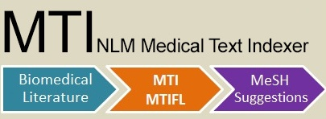
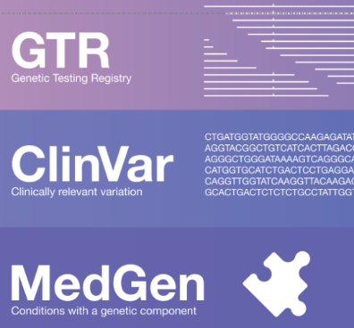
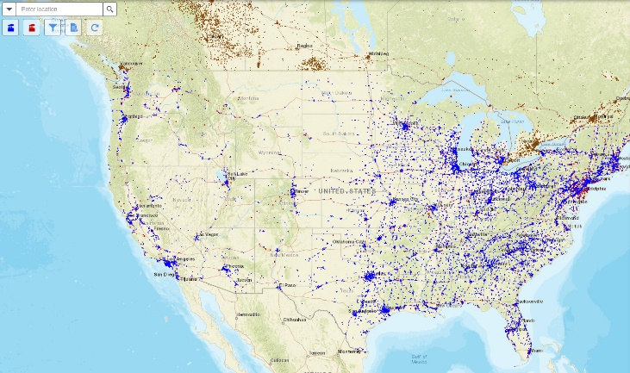
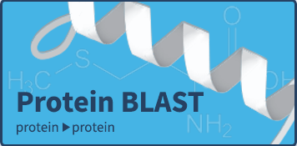
LactMed
Drugs and Lactation
Database
HSRProj
H
S
D
B
RxNorm
RefSeq
Reference
Sequence
Database
CHEMM
Meta Map Lite
VSAC
value
sets
TOXMAP
Notes:
NLM Resources and Services:
NOTE: Per Stephanie Morrison 8/23: confirmed plan to incorporate the consumer health genetics info from GHR into MedlinePlus, pending LO and OCCS agreement. Nothing publicly announced yet.

Slide 4
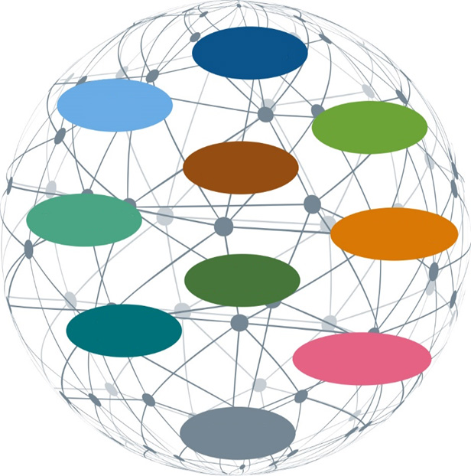
National Library of Medicine 10 Year Plan
Accelerate discovery & advance health through data-driven research
Reach more people in more ways through enhanced dissemination & engagement
Build a workforce for data-driven research & health
Protocols
Code
Funding
Models
Clinical Data
Library
Study Data
People
Instruments
Pathways
Notes:
A new Strategic Plan:
GOAL 1: Accelerate discovery and advance health by providing the tools for data-driven research
Objective 1.1: Connect the resources of a digital research enterpriise
Objective 1.2: Advance R&D biomedical informatics and data science
Objective 1.3: Foster open science policies and practices
Objective 1.4: Create a sustainable institutional, physical, and computational infrastructure .
GOAL 2: Reach more people in more ways through enhanced dissemination and engagement pathways
Objective 2.1: Know NLM users and engage with persistence
Objective 2.2: Foster distinctiveness of NLM as a reliable, trustable source of health information and biomedical data
Objective 2.3: Support research in biomedical and health information access methods and information dissemination strategies
Objective 2.4: Enhance information delivery
GOAL 3: Build a workforce for data-driven research and health
Objective 3.1: Expand and enhance research training for biomedical informatics and data science
Objective 3.2: Assure data science and open science proficiency
Objective 3.3: Increase workforce diversity . . .
Objective 3.4: Engage the next generation and promote data literacy

Slide 5
What Does NLM do to Support 21st Century Biomedical Communication?
Improve Usability of and Access to the Research literature
Promote Open Science and Data Sharing
Guiding 21st Century Scientific Communication
Notes:
How does NLM make AI Trustable, Transparent and Useful?
Common tools
Machine Learning
Natural Language Processing
Neural Networks
Deep Learning

Slide 6
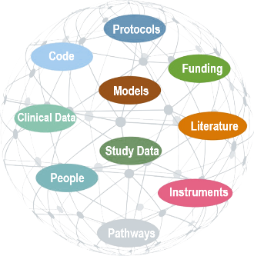
The 21st Century Collection
NLM
Preserve
Connect
Discover
011010101011010101010101010001110110011001100101010101110010
101010101010001
Literature
Data
Notes:
A National Library in the 21st century

Slide 7
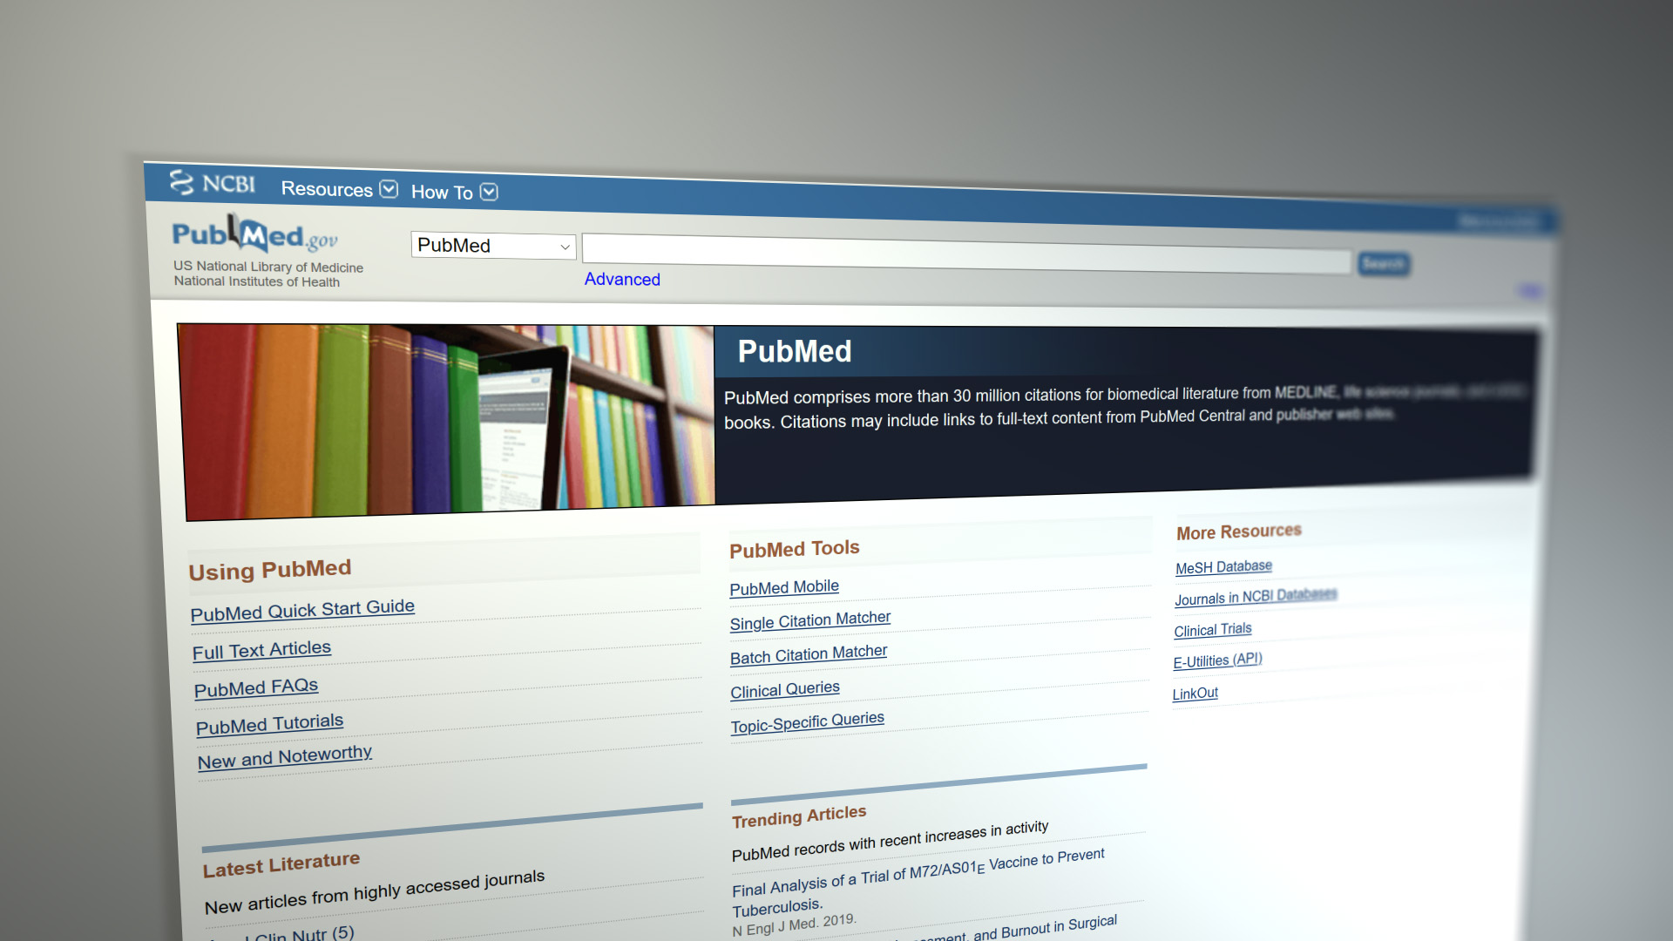
Improving Usability of and Access to the Research Literature
PubMed Daily Usage
30+ million articles
2.5 million users daily
~ 3 million searches
9 million page views

Slide 8
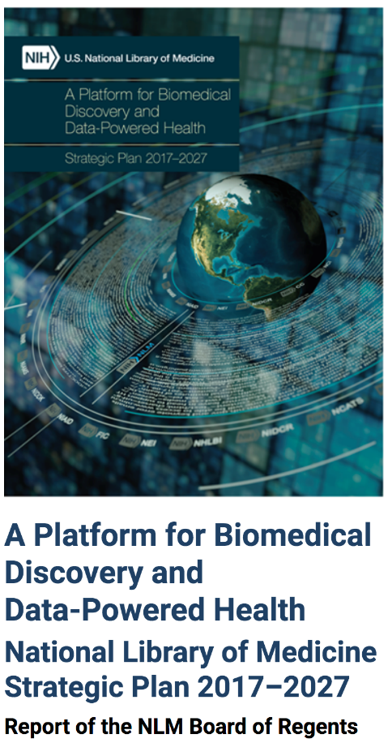
AI/Machine Learning (ML) for Improving PubMed
To improve search quality: help users to find the most relevant & high-quality info efficiently.
To improve usability: help users to have better experience with their literature needs.
Notes:
(OCPL/AA Note: Added “biomedical” to synch with written paragraph)
(OCPL/AA Note: OCPL re-write of first bullet (Original: Ensuring correct expert assessment of over 80,000 research proposals a year))

Slide 9
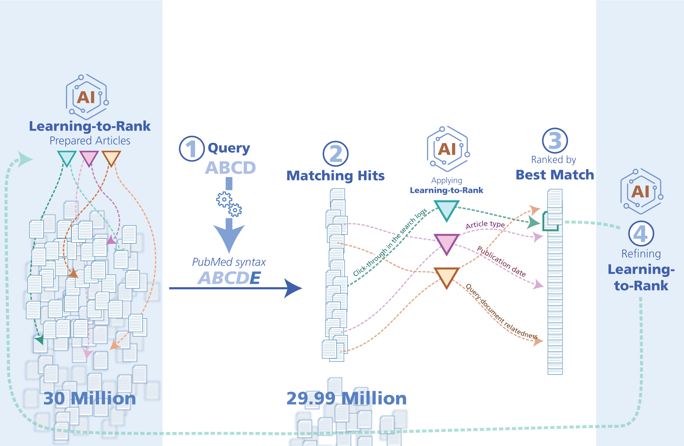
Learning-to-Rank

Slide 10
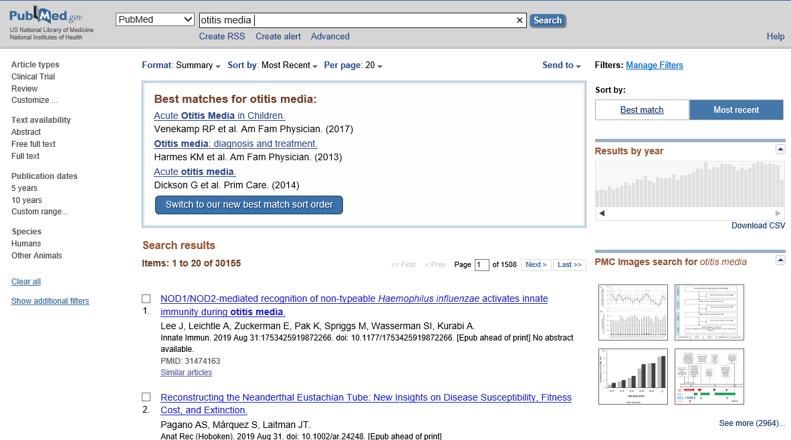
Best Match Algorithm Produces **Better** PubMed Results

Slide 11
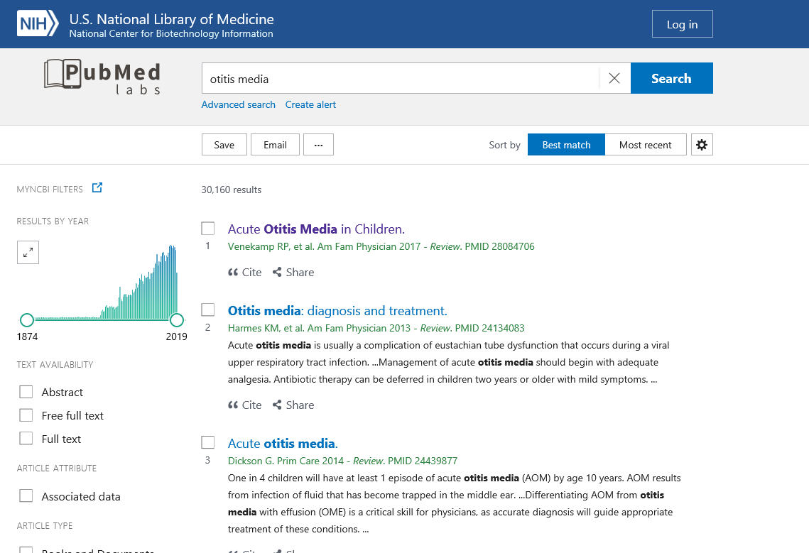
Explainable AI: Best Match with Snippets

Slide 12
Promoting Open Science and Data Sharing

Slide 13
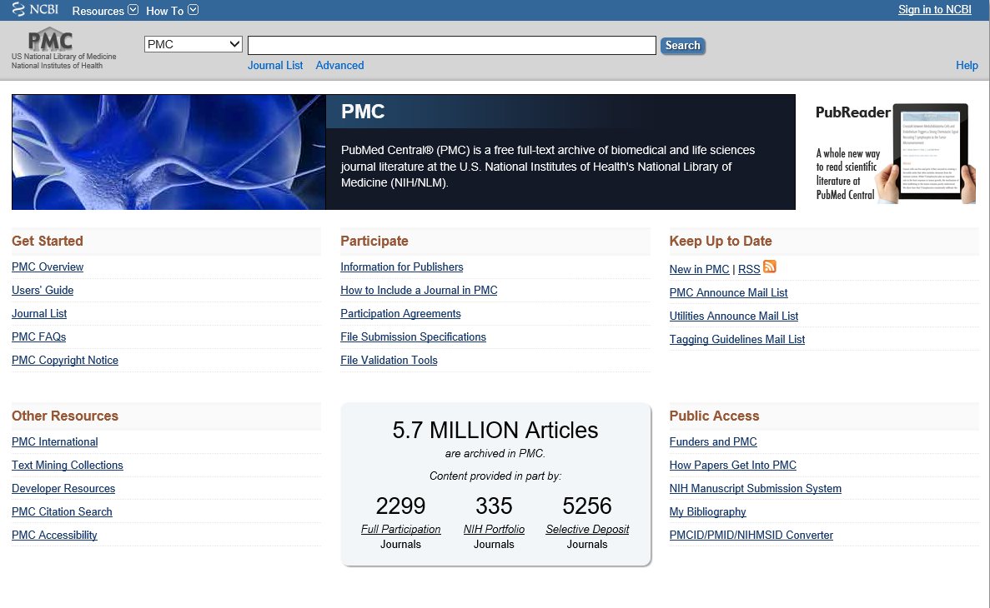
PubMed Central (PMC): Full Text Public Access

Slide 14
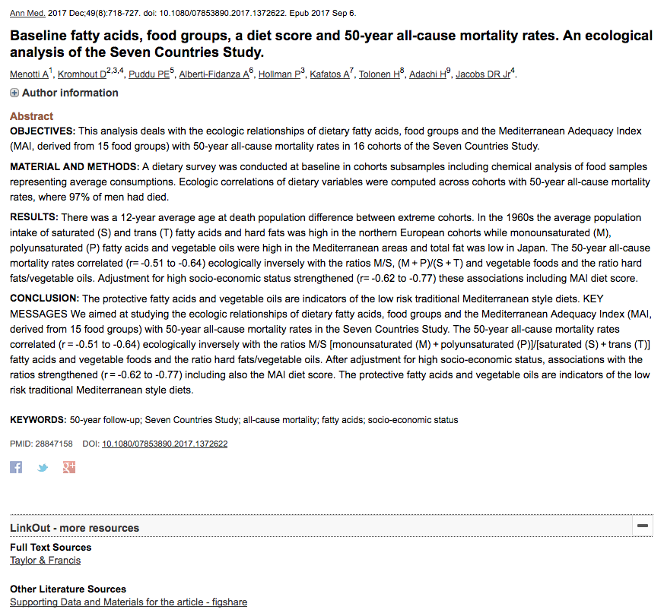
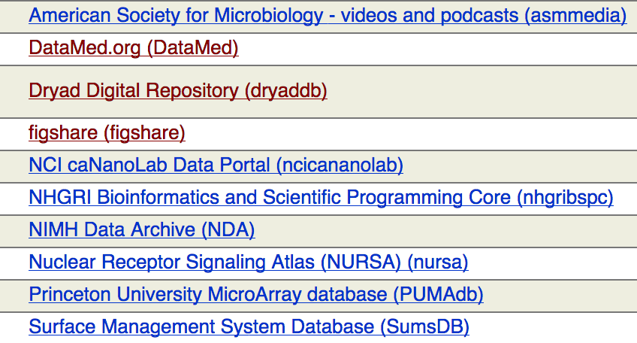
Data Links in PubMed:
Secondary Source ID, LinkOUT
Data Citations and Supplementary Data in PMC
Computer code
Mathematical or computational models
Audio or video clips
Oversized tables
Intervention protocols
Primary or supplementary data sets
Expanded methodology sections
Additional figures
Source: Publication Manual of APA (6th ed.)
loprovfigshare[Filter] OR loprovdryaddb[Filter]

Slide 15
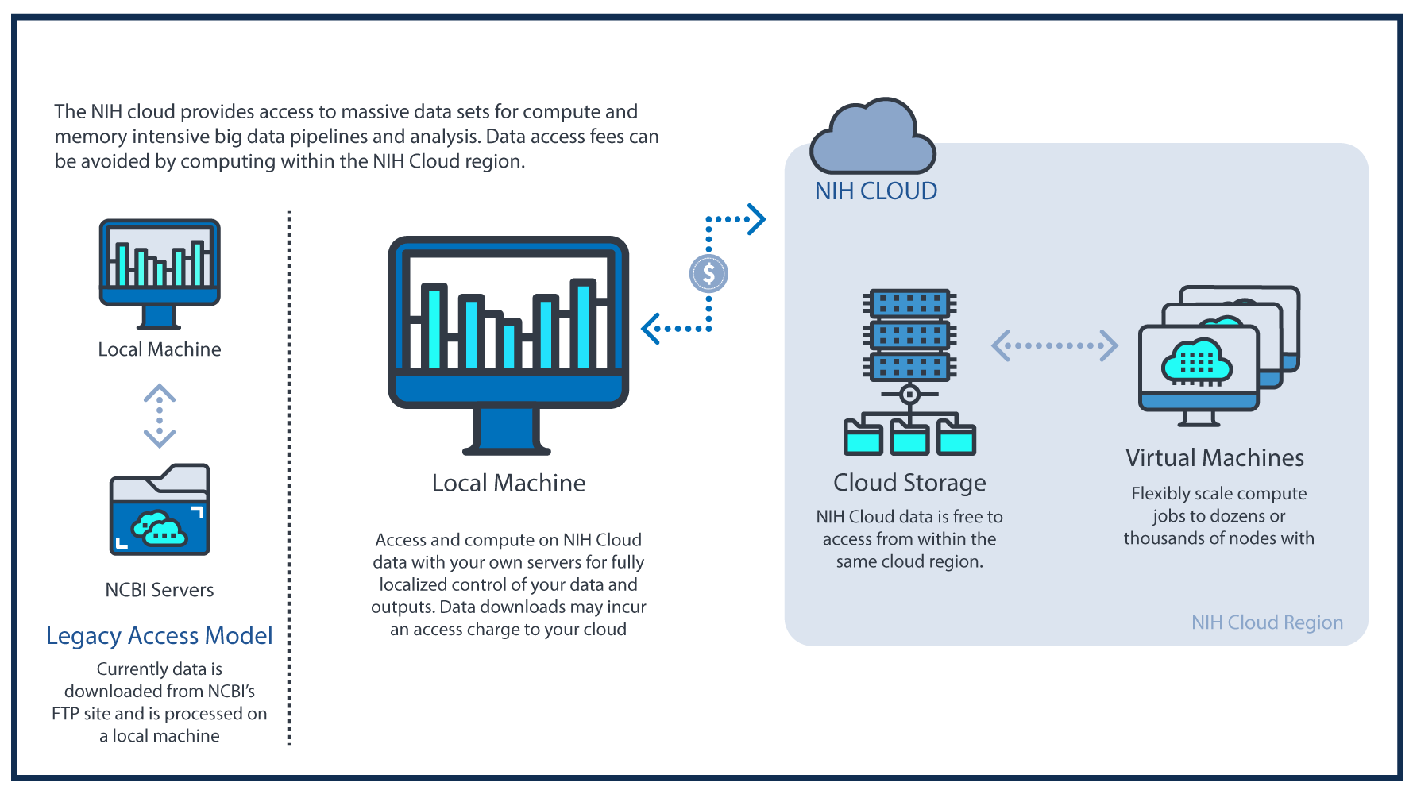
Sequence Read Archive in the Cloud
User Advantages
Immediate access
Multiple formats
Compute near data
Tools & Workflows
SRA toolkit
BLAST+, BLAST GCP
External PGAP
More coming…

Slide 16
Notes:
FHIR -> FAIR

Slide 17
Characterizing Models
Data elements
Model type
Purpose
Assumptions
Use
Scale
Model verification
Model validation
Notes:
Minimum data elements – what really matters?
Model type
Purpose
Assumptions
Use
Scale
Model verification – is it implemented properly
Model validation – does it match the real world

Slide 18
Improving the discoverability of the literature
This Photo by Unknown Author is licensed under CC BY-SA

Slide 19
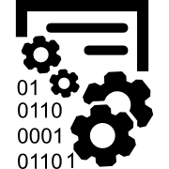
MEDLINE 2022
Curation at Scale
Expanded Metadata
Efficient and Connected
1 million or more citations indexed per year, to keep pace with publishers
Optimized metadata to support access to ClinicalTrials.gov and other trial registries
Publishers supply metadata and allow metadata extraction from full text
Citations indexed
within 24 hours, to meet user needs for discovery
Comprehensive genetic metadata to support the scientific research community
MeSH vocabulary and workflow enhancements support user needs
Automated indexing applied, to ensure efficient processing
Improved chemical metadata spanning pharmacological/
toxicological research areas
Authoritative vocabularies in addition to MeSH increase access
Expert human curation applied, to ensure indexing accuracy and quality
Enhanced funding metadata
to support research portfolio analysis
Links to datasets support NLM and NIH data science goals

Slide 20
1 million or more citations
indexed per year, to keep pace with publishers

Slide 21
Citations indexed
within 24 hours,
to meet
user needs for discovery
24-hour processing for all citations?
Automated indexing necessary
Human review of selected citations

Slide 22
Automated indexing applied, to ensure efficient processing
MTI/MTI-AUTO/MTIFL/MTI Review?
Other automated systems?
Terms extracted from full text and TIAB

Slide 23
Expert human curation applied, to ensure indexing accuracy and quality
How will indexing policy change?
How will indexing workflows change?
Answers depend on automation

Slide 24
Optimized metadata
to support access to ClinicalTrials.gov
and other trial registries
ClinicalTrials.gov and WHO registries
Data review workflows for identifiers?
Clinical trials PTs/indexing?
Extract metadata using LHC/NCBI tool

Slide 25
Comprehensive genetic metadata to support the scientific research community
Investigate searchers’ use of GeneRIFs
Reduce gene indexing complexity
Extract metadata using LHC/NCBI tool

Slide 26
Improved chemical metadata spanning pharmacological/toxicological
research areas
Integrate PubChem/RxNorm sources?
Work with FDA/similar projects
Extract metadata using LHC/NCBI tool

Slide 27
Enhanced funding metadata
to support research portfolio analysis
Increase publisher supplied metadata
Better align MEDLINE and PMC policies
Extract metadata using LHC/NCBI tool

Slide 28
Publishers supply metadata and allow metadata extraction from full text
Encourage publishers to supply metadata
Explore text mining possibilities
Extract metadata using LHC/NCBI tool

Slide 29
MeSH vocabulary and
workflow enhancements support
user needs
Update MeSH more frequently
Document workflows
More user tools such as MeSH on Demand

Slide 30
Authoritative vocabularies in addition to MeSH increase access
Agricultural Thesaurus and Glossary?
Thesaurus of Psychological Index Terms?
Other controlled vocabularies?

Slide 31
Links to datasets support
NLM and NIH data science goals
Identify best approaches for linking
Extract metadata using LHC/NCBI tool
Train staff in data science!

Slide 32
MEDLINE 2022
Curation at Scale
Expanded Metadata
Efficient and Connected
1 million or more citations indexed per year, to keep pace with publishers
Optimized metadata to support access to ClinicalTrials.gov and other trial registries
Publishers supply metadata and allow metadata extraction from full text
Citations indexed
within 24 hours, to meet user needs for discovery
Comprehensive genetic metadata to support the scientific research community
MeSH vocabulary and workflow enhancements support user needs
Automated indexing applied, to ensure efficient processing
Improved chemical metadata spanning pharmacological/
toxicological research areas
Authoritative vocabularies in addition to MeSH increase access
Expert human curation applied, to ensure indexing accuracy and quality
Enhanced funding metadata
to support research portfolio analysis
Links to datasets support NLM and NIH data science goals

Slide 33
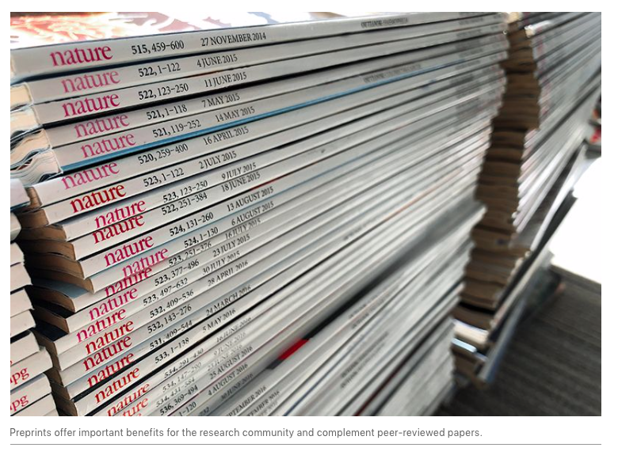
Preprints

Slide 34
NLM Preprint Pilot
Goal: Improve the discoverability of Preprints
The conditions:
Deposit a full text of the preprint in PMC
Associated bibliographic citation in PubMed
ALL RECORDS WOULD CLEARLY DENOTE THAT THE ITEM HAS NOT BEEN PEER REVIEWED
The experiment:
Limited to preprints of NIH supported research
Preprint must be available in full-text XML format
Preprint must have a license that allows for inslcuion in a non-commercial repository

Slide 35
NLM Preprint Experiment: Background
Accelerate access to scientific output of NIH funding
Encourages but does not require investigators to use preprints to speed the dissemination and enhance the rigor of their work. NOTE that preprints do NOT fall under the NIH public access policy.
Allows investigators to cite preprints as research products and claim them as products of NIH funding.
Encourages investigators to post preprints to repositories that make the content findable, accessible, interoperable and reusabe
Consistent with the NIH guidance on preprints (NOT-OD-17-050

Slide 36
Conditions
Preprints would not be submitted directly to NLM. Rather, NLM would work with preprint repositories/services that
Make content (metadata and full-text) available in a re-usable (e.g. use of Creative Commons licenses) and machine-readable (i.e., XML) format;
Have rigorous, transparent policies and practices to address plagiarism, competing interests, misconduct and other hallmarks of reputable scholarly publishing; and
Accurately maintain records of changes to preprints, providing a clear way to cite different versions of the product.

Slide 38
Reaching NLM
@NLM_news
patti.brennan@nih.gov
@NLMdirector

